Slide 1
Visit Bangladesh

Slide 2
Submitted By
S.M Shahriyar ( BSSE 0902)
Sudip Kumar Sah ( BSSE 1040)
Supervised By
Sumon Ahmed
Assistant Professor
Institute of Information Technology

Slide 3

INTRODUCTION
This is an android app to reduce effort to search famous tourist places and find the route for visiting tourist places of Bangladesh. The app will give you ample time to explore interesting places with your own places.

Slide 4

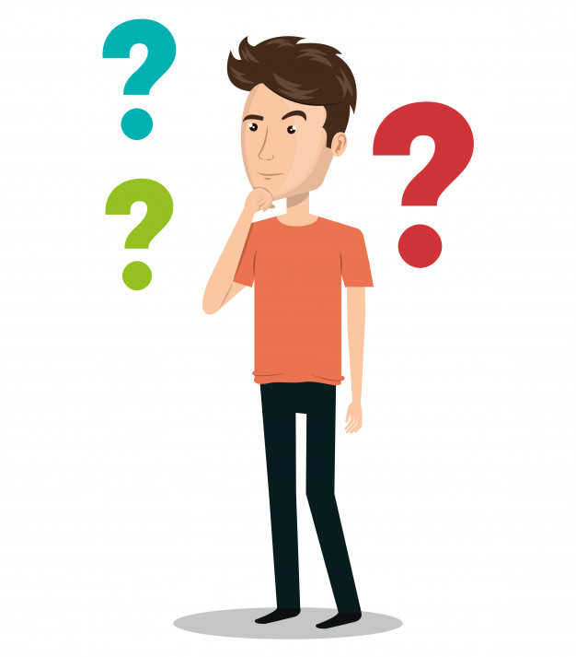
Before Using App
Search in Facebook Groups
Search in Google
কিভাবে যাবো
কই যাবো
খরচ কেমন
But unfortunately cannot get proper information

Slide 5
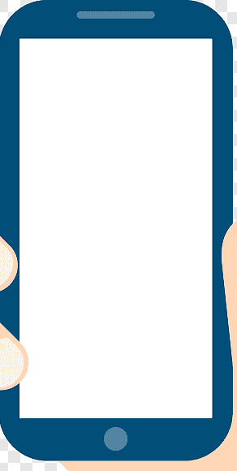

After Using App
Visit Bangladesh app will give you proper information about the place, you want to go.
And also know the previous experience of different travelers, place rating, route information, traveling way etc.
Visit
Bangladesh

Slide 6
Scope
The scopes of this project are-
User can view various tourist places division-wise of Bangladesh.
User can get different travel agencies contact info if he/she want to go with them.
User can get tourist place information at any time.
This app will allow emergency call and text, if the user face any trouble in that place.
User can add new tourist place and details with the user account.
User can know the way of route to go the destination place.

Slide 7
Motivation
Useful for travel lovers as well as general people.
Tourists from other countries use this app easily to visit Bangladesh.
Anyone can get idea about the beauty of Bangladesh by this app.
The project is android based aims at the development of Tourism Sector of Bangladesh.

Slide 8
Target Audience
Foreign Tourists
Travel Lovers
General
People

Slide 9
How Will it Work?
Sign in
Sign up
Skip
Can view, upload photo, add new place, comment, rate place, make emergency call
and message.
User:
Guest:
Only can view

Slide 10
Work Plan
1. Analyzing and specifying ideas: 2 weeks
2. Learn android and java: 2 weeks
3. Prepare SRS report: 4 weeks
4. Designing and Implementation: 4 weeks
5. Testing and Fixing Bugs: 4 weeks
6. Report writing: 3 weeks

Slide 11
THANKS!
Any questions?

